Slide 1
PPAP Responsibilities & Coaching Check List
21 April 2025

Slide 2
PURPOSE
The purpose of this document is to coach suppliers and internal associates within Handicare on the sequence of events and the document / check requirements for our Production Part Approval Process (PPAP).
This process is applied to all production parts intended for use within a finished device, that is manufactured and assembled in a Handicare facility. The process provides confidence in all supplied products, processes and sub-contracted processes by Handicare.
The PPAP package is a formal evidence-based process. Its output is a set of documents providing compliance to specification, performance, and delivery culminating with a formal sign-off approval from Handicare.

Slide 3
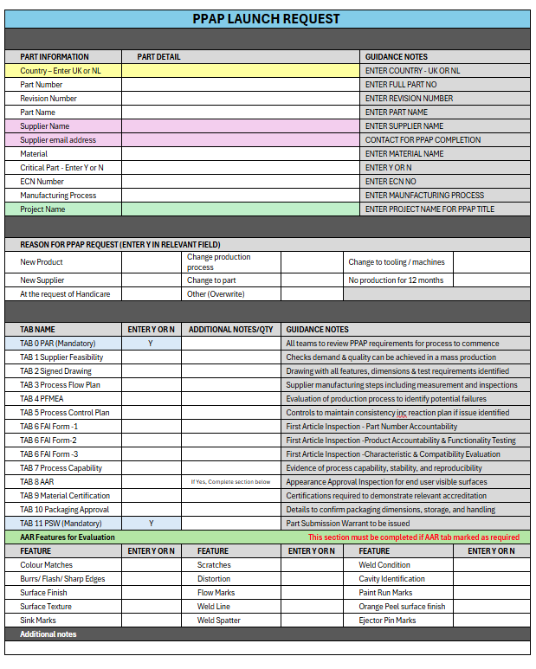
PPAP Launch Request
Step 0
Launching a PPAP, Step owner:- Strategic Purchasing
Download the current PPAP Launch Document stored on the SharePoint system.
Purchasing arranges a cross functional team review (includes team members from R&D, Purchasing, Domestic Quality & Supplier Development) to review the request.
Complete the document details to align to the PAR and include the features for review in AAR (Appearance Approval Report) if AAR tab is required for this project.
The launch document is forwarded to the Purchasing Admin coordinator to create a unique PPAP number and PPAP project folder.
The PPAP document is created using the details supplied on the PPAP launch request file.
Purchasing Coordinator activates the workflow which notifies the Handicare team using the automated notification prompts to invite them to complete the signature sign off & date boxes in the PAR tab.
Once the PAR has been fully signed the Purchasing coordinator is notified and shares the document via SharePoint to the supplier, for them to complete the relevant tabs requested.

Slide 4
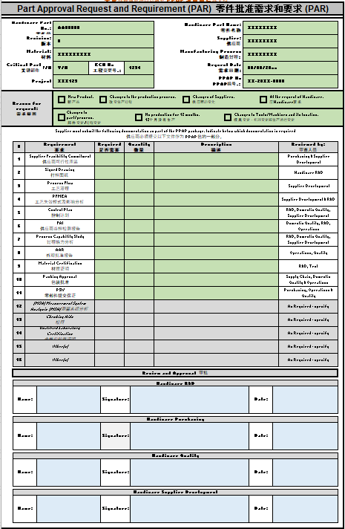
PPAP - Part Approval Request and Requirement (PAR)
Step 0
PAR Tab Sign Off, Step owner:- R&D, Strategic Purchasing, Quality and Supplier Development
Handicare Check:
That the header information corresponds to the drawing ref TAB 2, i.e. Part Number, Material, Revision level & Part Description.
That the header contains the, Criticality status, ECN No, Project, Supplier Name, Manufacturing Process, Requested By Date and PPAP number. If any detail is missing, please add the information.
The reason for the PPAP has been marked.
All required stages and quantities have been carried across from the launch document.
Quantities and any descriptions added and checked.
Following the Handicare team review, where all names, dates and signatures are completed on the PAR tab.
The workflow will send a trigger email to the Purchasing Coordinator, who then contacts the supplier to complete the required elements identified in the PAR.
Transferred from the Launch form
Notified by system e-mail.
Signed and Dated

Slide 5
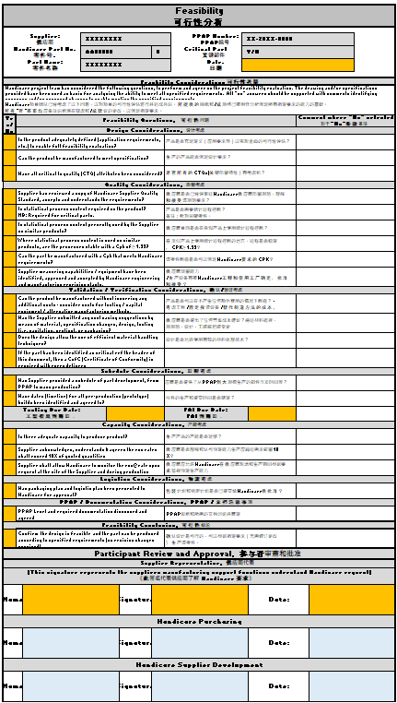
PPAP - Feasibility Review
Step 1
FEASIBILITY tab sign off. Step owner:- Strategic Purchasing and Supplier Development
Once the Feasibility tab is completed and submitted by the supplier, the Handicare Purchasing and Supplier Development shall review sign and date. to acknowledge.
Handicare Check:
In the Yes/No column, are all questions are answered
Any “No” answers must have a supporting comment.
If not, query any “No” answers with the supplier.
Confirm all CTQ and feature questions have been considered and acknowledged reference the capability study processing and on-going measurement surveillance.
CTQ capability study’s must be off a productionised processes for evaluation.
Confirm that there is a Tooling due date entered, if applicable.
Confirm that there is a FAI due date entered.
Completed by the supplier and submitted for review.
Notified by system e-mail.
Signed and Dated

Slide 6
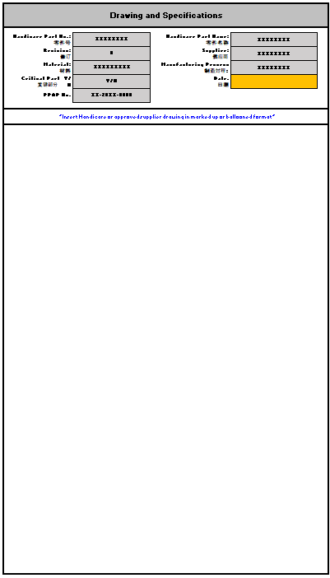
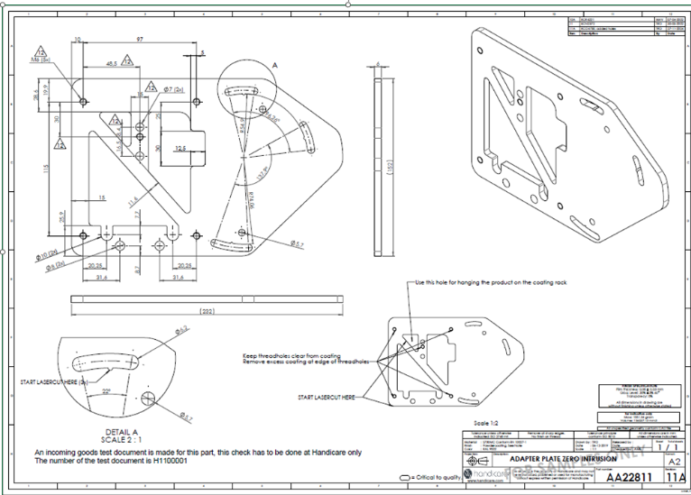
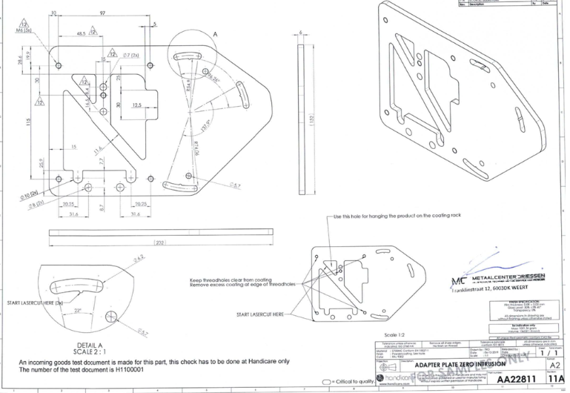
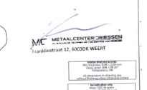

PPAP - Drawing
Step 2
Drawing Check, Step owner:- Supplier & Purchasing Coordinator
This drawing is the basis for the feasibility tab to be completed against
Supplier:
Confirm that the development drawing attached into the PPAP, is the correct revision as per the tab header box.
Add a scanned copy of the signed drawing, to acknowledge acceptance
Add the date into the highlighted box
  All other boxes are auto-filled from the PAR Tab
Handicare Check:
Confirm that the development drawing attached into the PPAP is the correct revision.
Confirm the supplier has acknowledged the drawing by adding a signed drawing and entering a date at the top of the document
Example of a signed off drawing that acknowledges receipt.
This is acceptable

Slide 7
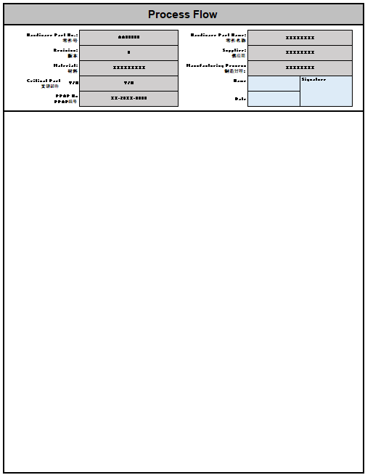
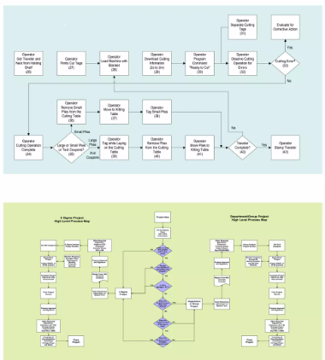
PPAP – Process Flow Map
Step 3
PROCESS FLOW - Step owner:- Supplier & Supplier Development
The Process Flow must identify every step in the process
Supplier:
Include abnormal handling processes
  Scrap
  Rework
  Receiving of raw material
  Part Manufacturing
  Offline inspection & checks
  Assembly
  Shipping
Handicare Check:
Confirm the header details match the drawing & correct revision level
Review the process flow submitted by the supplier meets the above requirements.
If there are any queries or missing information please reject the document via the purchasing coordinator.
Once approved, sign the tab header (blue) to confirm acceptance.

Slide 8
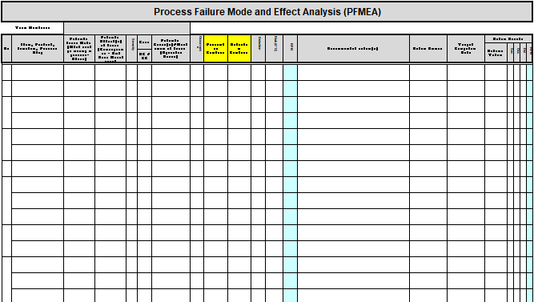
PPAP - Process FMEA
Step 4
Process (PFMEA) is owned and generated by the supplier.
Handicare acknowledge that PFMEA is intellectual property and may not be available to be shared electronically by the supplier.
  If so, Handicare R&D, Engineering function or its delegate may review the document at the supplier’s premises to ensure that the document exists and its currency.
Handicare will accept PFMEA on the suppliers own template.
PFMEA - Step owner:- Supplier & Supplier Development
Once the PFMEA tab is completed and submitted by the supplier, (or when conducting a review of the document on site with the supplier) the Handicare team shall complete the following checks.
Handicare Check:
Header aligns to the Handicare drawing and its revision level
Review the document header information is linked to the control plan and the drawing and its revision level
Check that the RPN numbers are under the stated limits
All high RPN’s are supported by “Recommended Actions” have an Owner, Target date and a revised/improved RPN number
Any high RPN concerns are carried over into the control plan
Make sure that all critical failure modes are addressed
  Safety
  Fit, Form & Function
  Material Concerns

Slide 9
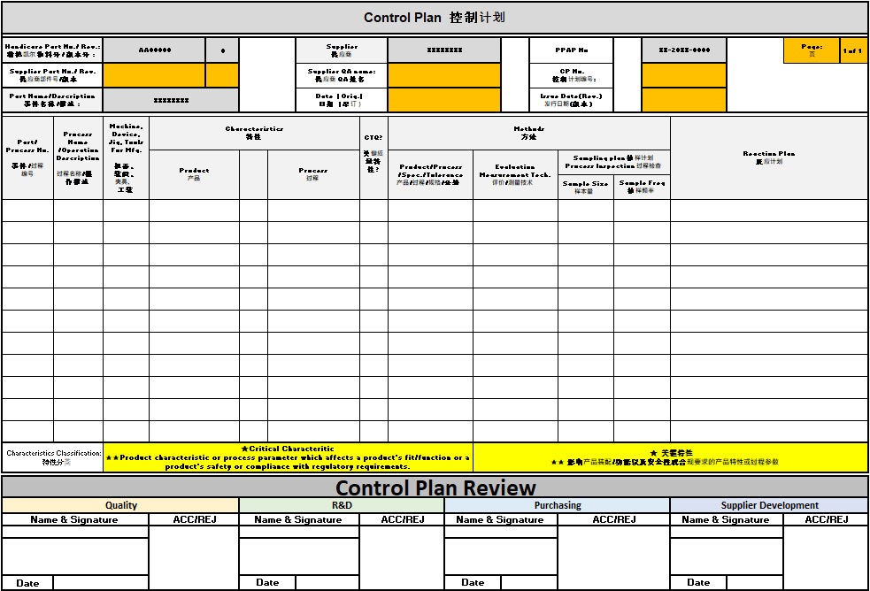
PPAP – Control Plan
Step 5
Control Plan
Step owner : Supplier, Handicare Supplier Development & Quality
Supplier
Control Plan document header has been completed and can be linked to the Process Flow plan. Other details are auto filled.
The Control Plan can be accepted on a supplier's template but header must align to Handicare detail Part No and revision level. This can be pasted onto the control plan tab or attached to the appendix page in Tab 6.
Handicare Check:
The header information corresponds to the drawing & revision level
The plan contains details
  Raw materials check (what document verify the product is correct)
  First off check (Features that confirm the part set is correct)
  In-process checks (Realistic frequency & sample sizes on features, especially on CTQ’s if requested)
  Last off check (Features that confirm the part finished correct)
  Visual checks
  Reaction plans for Non-conforming material

Slide 10
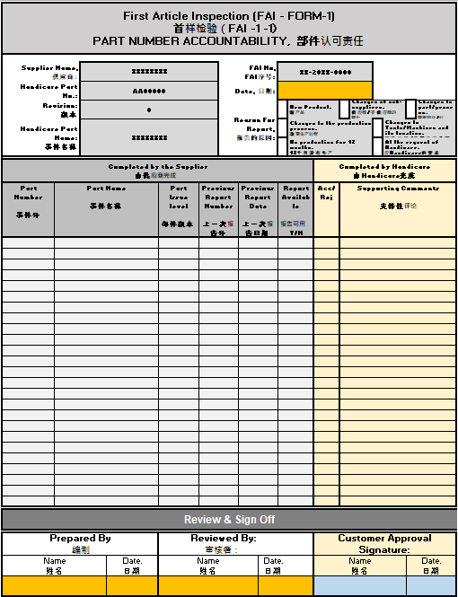
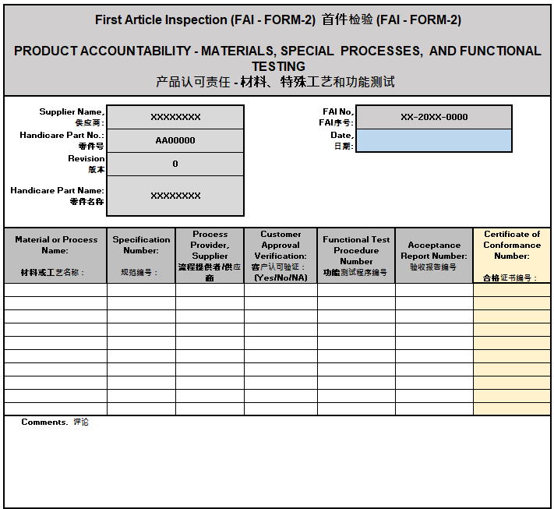
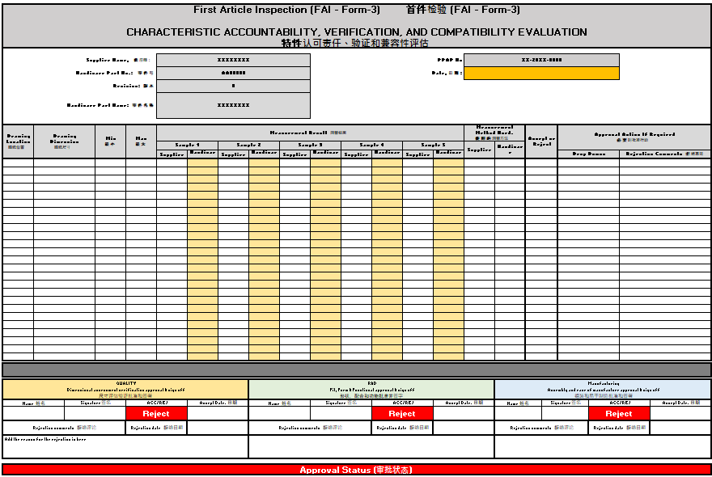
PPAP – FAI (First Article Inspection)
Step 6
FAI ( First Article Inspection) Tab 1 2 & 3
The supplier shall submit an FAI report for a minimum of 5 pieces or assemblies, unless otherwise agreed
The FAI submission consists of 3 Forms
  FORM-1, List of part numbers for an assembly and capture historical data
  FORM-2, Product Accountability – For any Materials, Special Processes & Functional Testing completed
  FORM-3, Characteristic Verification & Evaluation
  Recorded sample details must align to features on a marked up print or ballooned drawing.

Slide 11
PPAP – FAI (First Article Inspection) – Form 1
Step 6
FAI ( First Article Inspection) FAI - FORM-1, Part Number Accountability
Step owner – Supplier & Quality
Supplier:
List of FAI submission details…
  For a SINGLE piece list part number for the FAI submission
  The document should list if relevant
    The part or sub-assy previous ISIR or PPAP No and Issue level.
    Previous report date.
    Previous is available from the supplier
For an ASSEMBLY list the piece parts or sub assemblies involved in the assembly as detailed above.
Handicare Check:
A PDF copy of the relevant approval documentation for each piece part or sub-assy listed should has been attached or embedded into FAI Appendix Sheet.
  Acceptable Evidence…
    An ISIR to the required piece part issue level.
    A PSW of the required piece part at the required issue level.
    For catalogue items, a copy of the material certificate and/or CofC (Certificate of Conformity)
Check the supplier has completed dated, Prepared by and Reviewed by sections.
Handicare endorse document post the check for the supporting documents.

Slide 12
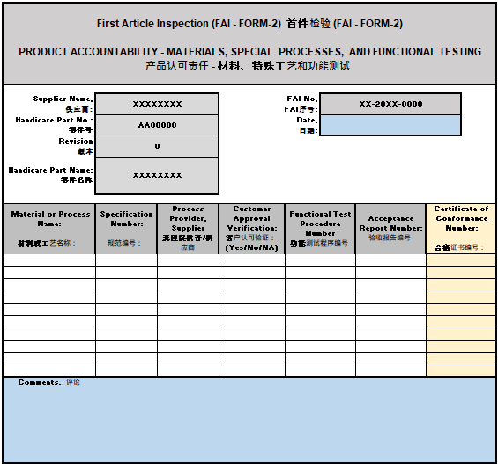
PPAP – FAI (First Article Inspection) - Form 2
Step 6
FAI ( First Article Inspection) FAI - FORM-2, Product Accountability- Materials, Special Processes & Functional Testing
Step owner – Supplier & R&D
Supplier:
Complete the FAI Form-2 with details of special processes & functional testing completed that aligns to piece parts or assemblies for the FAI submission
List any Special Processes & Functional Testing that support the FAI submission that relate to the design requirement .
  Examples for consideration
    Heat treatment that can affect performance
    Endurance Testing
    Functional Testing
    Laser Etching
    Painting and Plating salt spray or adhesion test to confirm compliance to the drawing or stated specification.
Complete the section for review if required. Add any comments before and date prior to submission to Handicare
Handicare Check :
Check and agree any 3rd party test work performed and add certificate or test report number from Handicare

Slide 13
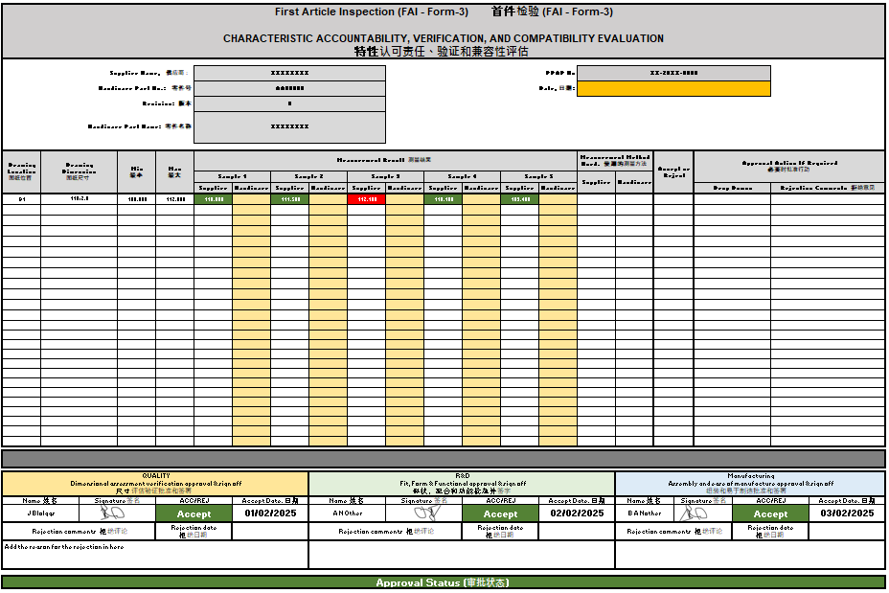
PPAP – FAI (First Article Inspection) – Form 3 Supplier
Step 6
FAI ( First Article Inspection) FAI - FORM-3, Characteristic accountability, Verification & Compatibility Evaluation
Step owner – Supplier, Quality, R&D and Manufacturing
Supplier:
The supplier shall submit an FAI report for a minimum of 5 pieces or assemblies unless otherwise agreed prior to PPAP submission.
Each sample should correspond to the sample number measurement detail
List all the features contained on the supplied drawing the relate to the design, Features to be recorded:
    All dimensions regarding the finished assembly
    Measurement equipment used
    All Note details
All features on the marked-up print or ballooned drawing are to align to the Form-3, dimensional report, and should be within the stated specification unless otherwise declared.
Any out of condition dimensions or notes must have written acceptance from Handicare to avoid instant rejection

Slide 14
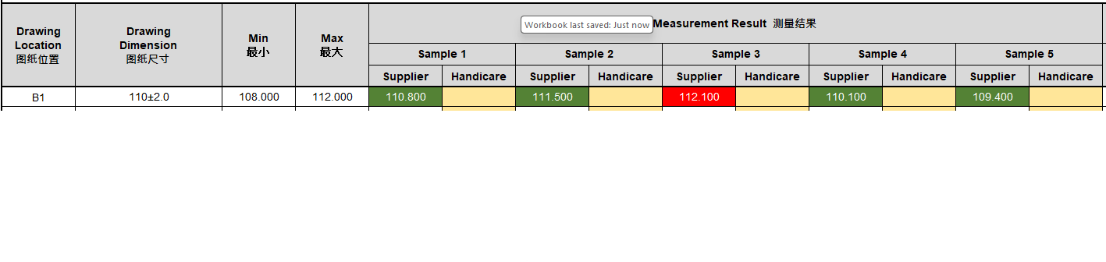
PPAP – FAI (First Article Inspection) – Form 3 Handicare
Step 6
FAI ( First Article Inspection) FAI - FORM-3, Characteristic accountability, Verification & Compatibility Evaluation
Step owner – Supplier, Handicare Domestic Quality, R&D and Manufacturing
Handicare Check :
The header information corresponds to the drawing
All elements of the FAI pack are available
No Red results unless supported by documents in the appendix tab and approved by Handicare R&D.
Dimensional check concurs with supplier’s results (No Red results)
Gauging or Measurement equipment has been declared
For Catalogue or Stockist items i.e. grease, washers, gaskets and seals etc Handicare only require a copy of the
  The PO for traceability
  Certificate of Conformity (CofC )
  Material certification
If the dimensional report is Accepted, Name, Sign & Date.
In the case of a Rejection, please supply comments for the rejection

Slide 15
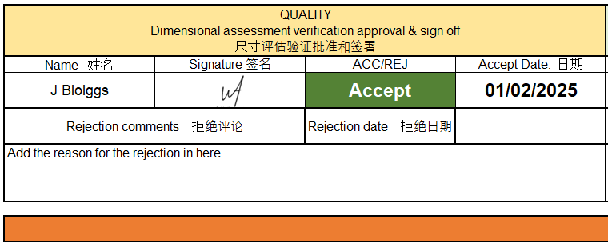
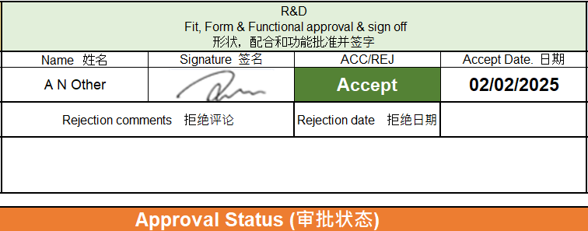
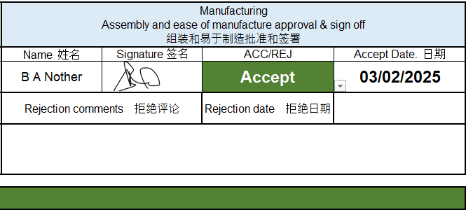
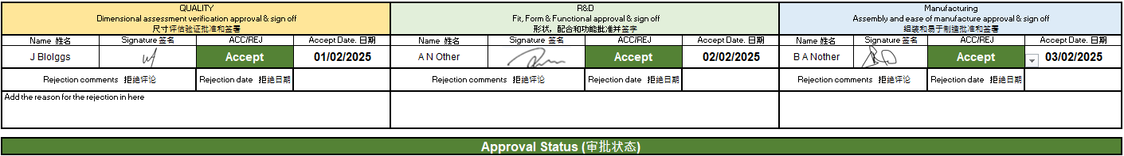
PPAP – FAI (First Article Inspection) Form 3 - Approval
Step 6
FAI ( First Article Inspection) FAI - FORM-3 Sign Off,
Characteristic accountability, Verification & Compatibility Evaluation
Step owner – Supplier, Handicare Domestic Quality, R&D and Manufacturing
The FAI Sign off is completed in 3 stages and is the same for both Component and Assembly FAI submissions
Domestic Quality shall complete the Dimensional assessment section. If satisfactory the parts and documentation are sent to R&D for Fit, Form & Functional approval
R&D complete the Fit, Form & Functional and Endurance section post test and assessment of a sample component or assembly. R&D complete there sign off on approval.
Manufacturing confirms the DFM or (Design For Manufacture) has not impacted manufacturing on assembly.
Acceptance of the FAI samples DOES NOT allow for full production to commence.

Slide 16
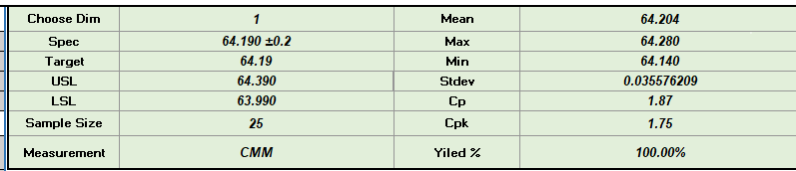
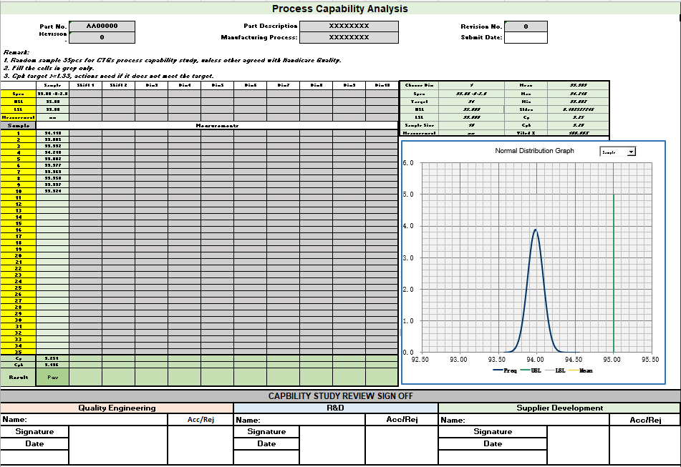
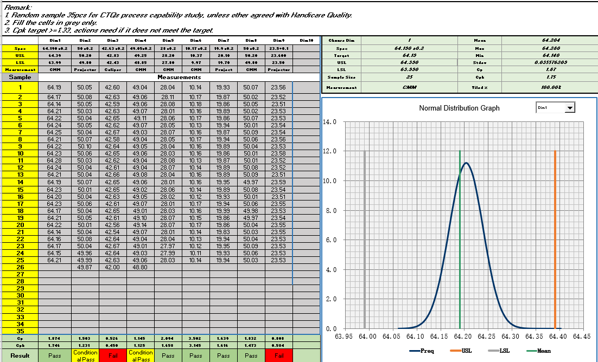
PPAP – Process Capability - Supplier
Step 7
Process Capability
Step owner – Supplier, Supplier Development
Supplier:
The suppler shall submit/provide Process capability measurement data for a minimum of 30 pieces made from production set up on all CTQ features and those features considered as critical by R&D during the feasibility review
In case of Moulding or castings the above applies of each cavity
In case of Mouldings measurement is taken prior to applying the textured finish (if applicable)
For machined items measurement data for a minimum of 30 pieces from each of the proposed machining centres and ideally from each shift (For example: Day/night shifts)
Features identified as Critical To Quality (CTQ’s) shall have on-going measurement surveillance supported regular periodic measurement monitored using Statistical Process Control (SPC) or via checking fixtures

Slide 17

PPAP – Process Capability - Handicare
Step 7
Process Capability
Step owner – Supplier, Supplier Development
Supplier:
All CTQ dimensions or feature(s) requested by Handicare R&D are to appear on the capability sheet record sheet
Handicare Check:
The data is calculated automatically in the sheet. A Pass condition is indicated in Green with CP & Cpk values being greater than <1.33.
A Yellow boxes indicates a Conditional Pass with CP & Cpk values being greater within the range of <1.00 – 1.33. Acceptance for these results must come from R&D, Engineering function or its delegate.
Reject submission for Red Fail features
CTQ’s that are monitored by use of a checking aid or fixture must have measurement detail traceable back to national standards supported by a realistic sampling frequency and is in the supplier's calibration programme.
This shall be identified in the Control plan and is advised in the Feasibility section.

Slide 18
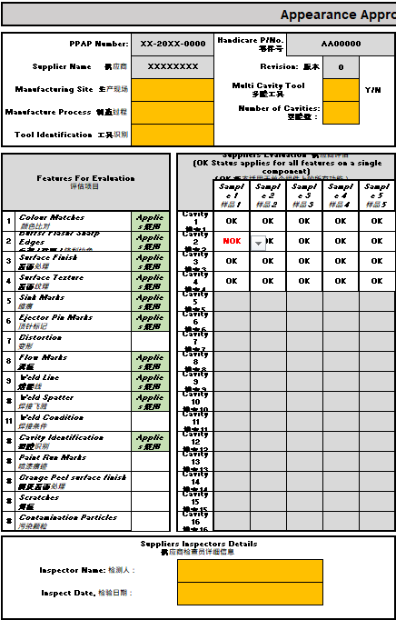
PPAP – Appearance Approval Report (AAR) - Supplier
Step 8
AAR
Step owner – Supplier, Domestic Quality
Supplier:
The suppler shall complete the supplier’s section of the AAR (Appearance Approval Report) against the finish criteria captured on the launch document pre-PAR
Samples submitted to be off production intent tooling. The samples should have the surface finish treatments i.e. colour, graining, plating, paint etc for evaluation.
Record results against the stated sample size taking care to identify the sample for cross check by Handicare.
In the case of moulded parts or castings x5off samples are required from each cavity i.e. x4off impression mould tool will be 4x5 = 20 samples for evaluation.
Supplier Sign & date the report before submission for review.
N.B. This activity takes place POST adding the texturing to the tooling where possible.

Slide 19
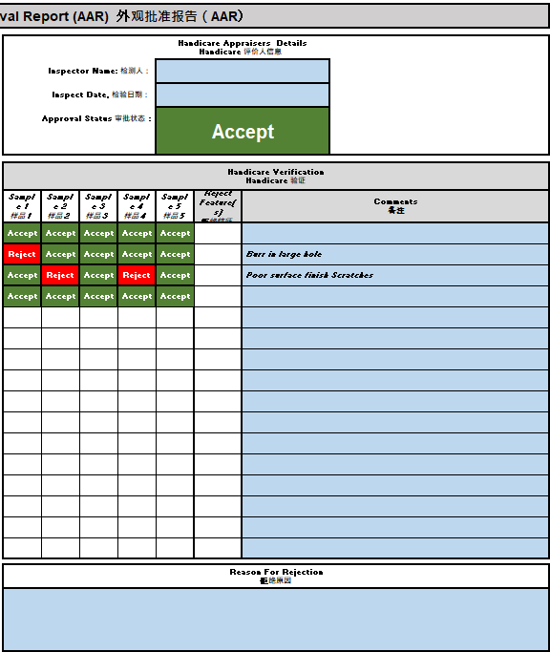
PPAP – Appearance Approval Report (AAR) - Handicare
Step 8
AAR
Step owner – Supplier, Domestic Quality
Handicare:
The header information corresponds to the drawing
Confirm and agree the supplier results. Refer to drawing specification, Gold samples, Colour swatches, Surface finish gauges where possible.
For mouldings check that there is a cavity number if declared
Check all samples submitted of each cavity
Record on the AAR document the Handicare results. Capture any difference of evaluation on a feature and record the failed feature number in the corresponding sample.
For a rejection, supply comments on why the sample was rejected as non-conforming and reference any gauges, colour swatches etc.
If acceptable, complete the AAR report. Add inspectors name and date

Slide 20
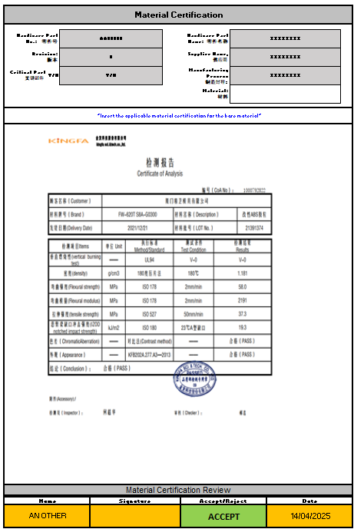
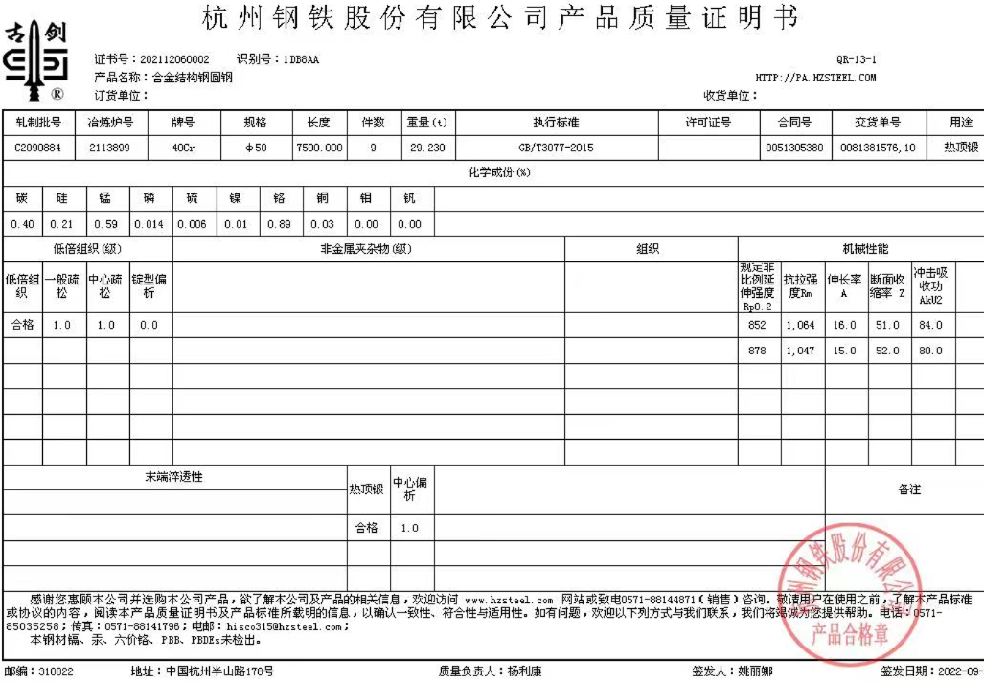
PPAP – Material Certification
Step 9
Material Certification D0OMESTIC QUALITY and R&D
Step owner – Supplier, R&D
Supplier:
The supplier shall provide documentation that confirms the product materials when chemical, physical or metallurgical requirements are specified
Enter the date certificate was submitted to Handicare, into header.
2. Material certification considered for Inclusion are:
  Raw material. (Mandatory)
  Plating/Coating (Mandatory)
  Heat treatment parts have test piece results (Mandatory)
  Plating/Coating endurance testing (If required)
Handicare Check:
The header information corresponds to the drawing
For Raw Material, Plating and Heat treatment…
  Traceable back to the submitted samples.
  Certification results and test requirement comply to Drawing specification
Laboratory or Test service providers to be linked to national standard organisations.
Sign to confirm certificates have been accepted in bottom section.

Slide 21
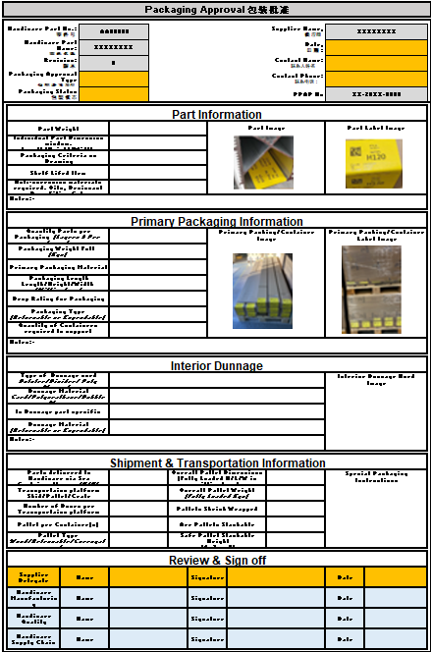
PPAP – Packaging Approval
Step10
Packaging Approval
Step owner – Supplier, Supply Chain, Domestic Quality & Manufacturing
Supplier:
The suppler in conjunction with Handicare Supply Chain and Manufacturing team shall develop and agree the delivered part packaging approval.
Elements to be considered:
  Packaging type (Expendable or Returnable, Kanban)
  Individual Part – Weight, Label, Shelf life? Anti-corrosion materials
Primary packaging information:
  Parts quantity & Packaging case dimensions per case (Layers & per layer)
  Packed laden weight and materials
  Quantity of stillages/boxes required in the system
Packaging & Shipment Information (Environmental, Health & Safety)
  Dunnage materials (Card/Polyurethane/Bubble-Shrink Wrap etc.)
  Container type Wood, Cardboard, Metal
  Full pallet weight, Quantity per pallets/containers
  Stackable, Weight and height
Handicare Check:
  The required data and images have been submitted
  Supplier representative has signed and dated document

Slide 22
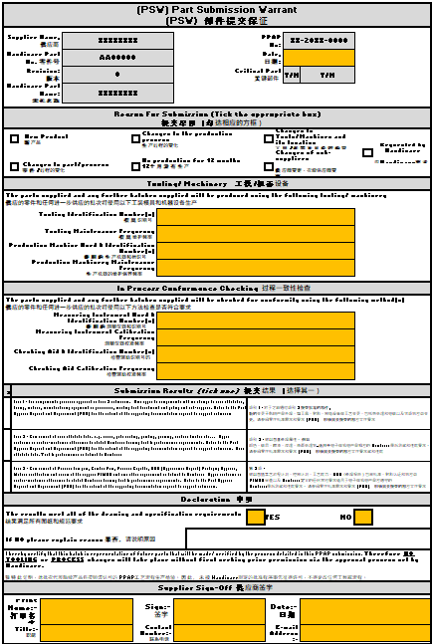
PPAP – Part Submission Warrant (PSW) – Supplier
Step11
Part Submission Warrant (PSW)
Step owner – Supplier
Supplier:
The supplier shall check and populate the sections as listed:
  The “Reason for PPAP submission” has been marked and the details in the header completed
  The “Tooling” and “In Process Conformance” sections have been completed. This detail, machine numbers, tooling numbers and the checking media numbers align with those on the control plan.
  The submission pack level has been marked (1, 2, or 3)
  The Declaration and Sign off sections are all completed.

Slide 23
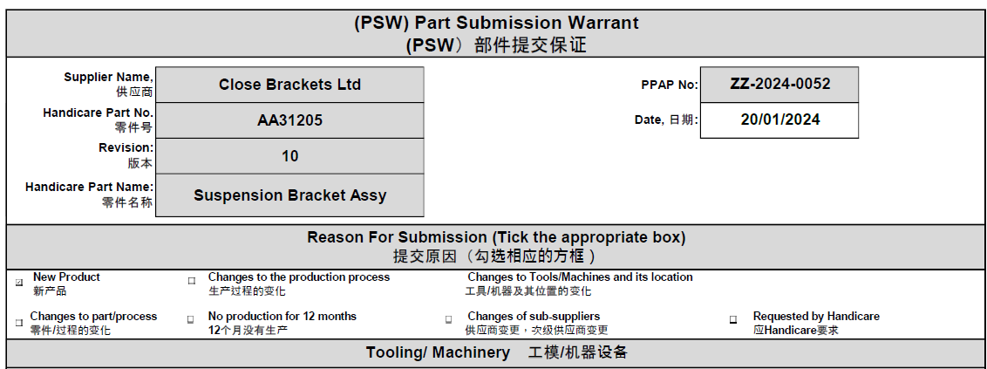
PPAP – Part Submission Warrant (PSW) - Handicare
Step11
Part Submission Warrant (PSW)
Step owner – Purchasing Coordinator
Purchasing Coordinator:
  Once all the supplier has submitted their updates, the Purchasing coordinator shall arrange for the PPAP to be updated with the Production Release drawing and update the revision level in the header, then trigger the workflow to commence the PSW sign off process
  Each of the signatories shall be notified that their section of the PSW is now available for sign off
    Purchasing
    Process/Manufacturing Engineers
    Quality

Slide 24
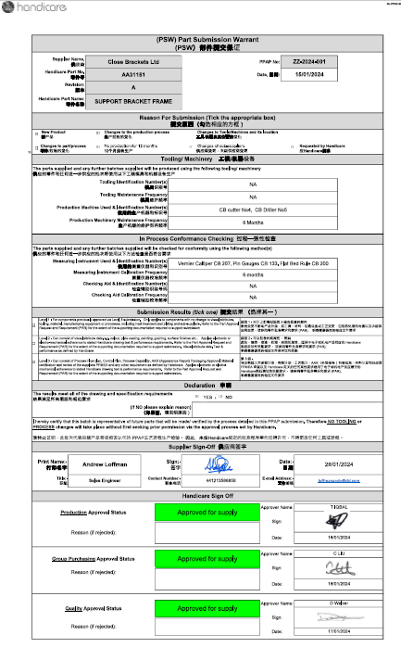
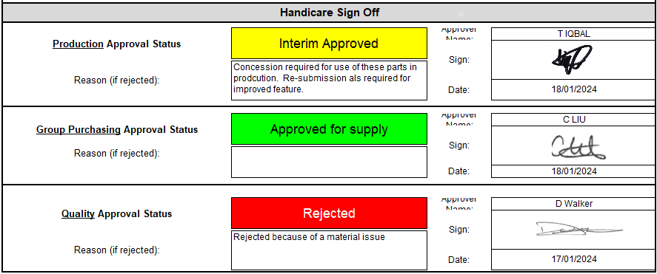
PPAP – Part Submission Warrant (PSW) - Handicare
Step11
Part Submission Warrant (PSW) - Part Submission Warrant (PSW) Sign off Step owner – Purchasing, Domestic Quality & Manufacturing teams
Handicare shall populate the bottom section of the PSW document. Providing all the above sections have been completed.
    The named departments shall picture or “wet sign” and date their section. See example 1 and set the Approval box to GREEN
    In the event of an “Interim Approval” YELLOW the signee shall provide a statement for interim approval and state a time limit or quantity for its effectiveness.
    In the event of an “Rejection” RED the signee shall add a statement for why PSW was rejected. See example
  When the PSW has been sentenced and fully signed, Purchasing coordinator will send a PDF version of the PSW and copy of the production release drawing to both Supply Chain and Strategic Purchasing, who shall then inform the Supplier and arrange a schedule for parts against the latest PSW.
Example 1
Example 2

Slide 25
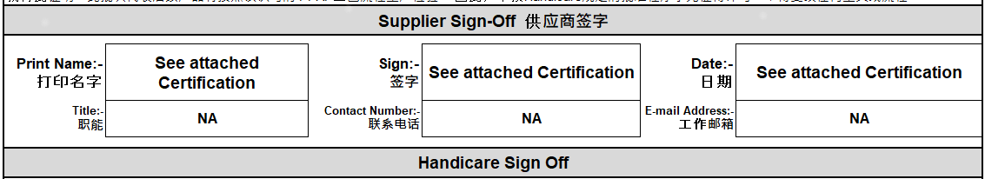

PPAP – Part Submission Warrant (PSW) Sign off
For an Off the Shelf/Catalogue Item
Step11
Part Submission Warrant (PSW)
Step owner – Supplier, Domestic Quality & Manufacturing teams
Part Submission Warrant (PSW) Sign off process
for an Off the Shelf Item or Catalogue Part
Check:
    Complete the “Reason for PPAP submission” has been marked and the details in the header are all filled in.
    The Tooling and Process and Conformance Checking sections must be completed. In this event NA all the boxes.
    The submission pack has been marked in this event as level 1
    For the Declaration and Sign off section, providing we have Material Certification or a Certificate of Conformity we can mark the boxes as below
    Follow the same sign off process as per manufactured/ assembly items.
10

